Slide 1
Business Problems
Yearly Performance → How much Sales and Profit were generated each year, and whether the trend shows growth or decline.
Category & Sub-Category Analysis → Which categories and sub-categories contributed the most profit, and which ones went into loss.
Regional & State Performance → Which regions and states generated the highest revenue and profit.
Customer Segments → Which customer segment (Consumer, Corporate, Home Office) contributes the most.
Top Customers → Identify the top 5 customers each year, based on both Sales and Profit.
Discount Impact → Does offering higher discounts increase sales, or reduce profit margins?
Shipping Performance → Which shipping mode is most commonly used, and how is the average delivery time.
KPI Summary → Yearly key performance metrics like Sales, Profit, Orders, Average Order Value (AOV), Profit Margin %, and Delivery Days.

Slide 2
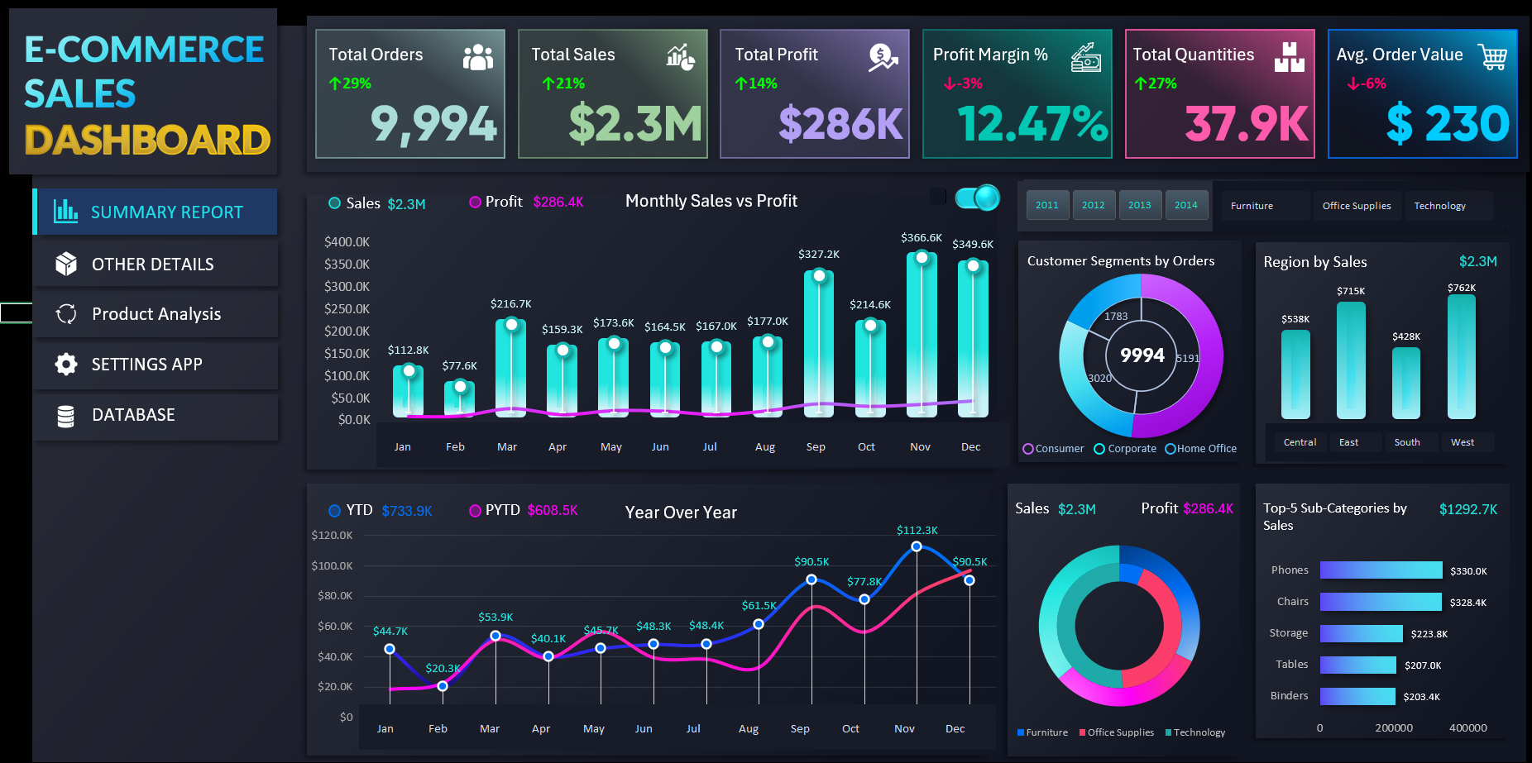

Slide 3
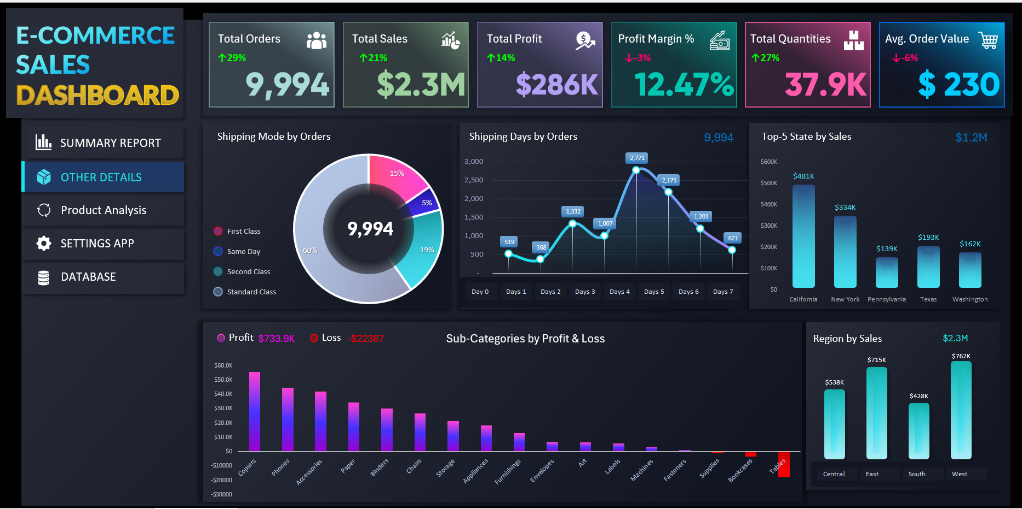

Slide 4
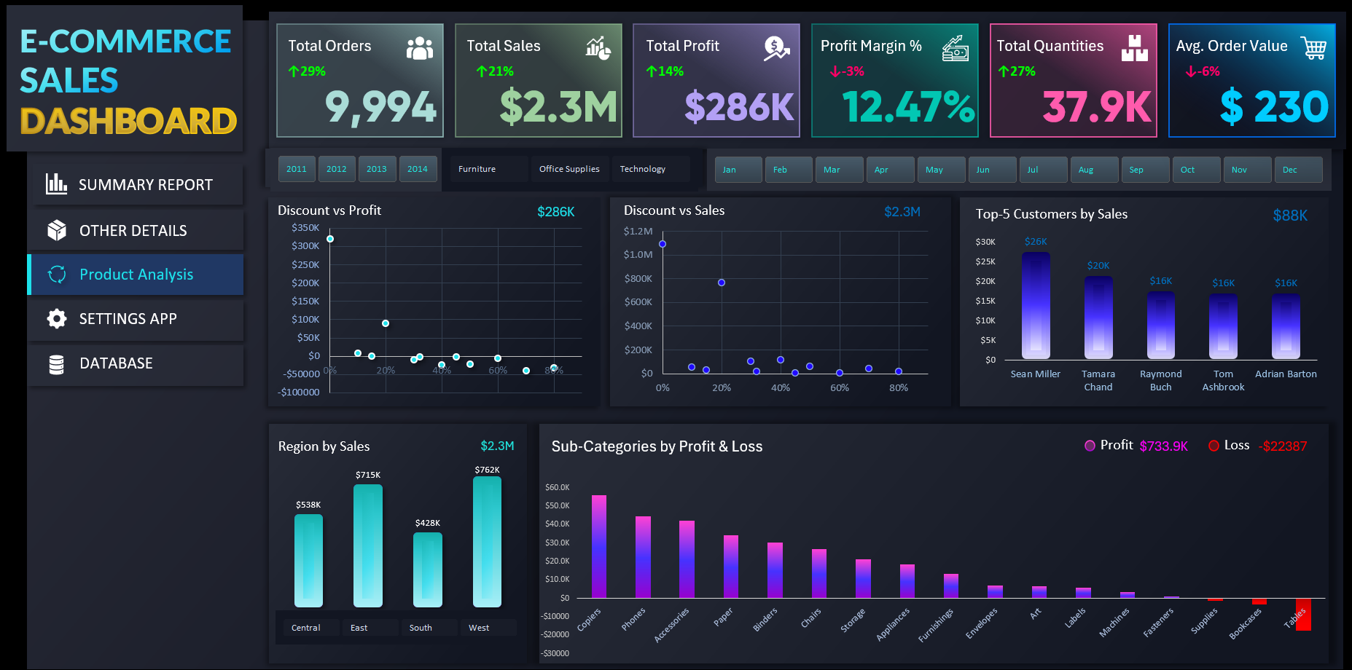

Slide 5
Key Insights from E-Commerce Sales Dashboard
KPI Performance
Achieved $2.3M sales and $286K profit over 4 years with a 12.5% margin.
Year-over-Year growth: Orders, Sales, and Profit all increased, showing consistent positive trend.
Seasonality & Monthly Trends
Strongest months: November–December & March.
Weakest months: January & February.
Winters drive high sales, while summers need marketing campaigns to boost performance.
Category & Product Insights
Technology & Office Supplies → high profit generators.
Furniture → high sales but weak/loss-making margins (–$22K loss from Tables, Bookcases, Supplies).
Key growth products: Phones, Chairs, Storage, Binders.

Slide 6
Discount Effect
Discounts of 10–20% increase both sales & profit.
Beyond 20% → profitability drops sharply.
Strategy: Apply targeted, controlled discounts.
Regional & State Insights
West & East → top performing regions.
South region → weakest, requires focused strategy.
California & New York → star states for expansion.
Shipping Performance
Standard Class (60%) → most preferred.
Customers expect 3–5 day delivery; orders drop if slower.
Optimize shipping for cost + speed balance.
Overall Conclusion
Positive growth, but profitability challenges in Furniture.
Seasonal trends matter → leverage winters.
Controlled discounting & regional focus can drive stronger performance.
Efficient shipping ensures customer satisfaction.

